Slide 1
Professional JavaScript for
Web Development [Chapter-3]
PRESENTED BY:
DAW SAW THANDAR SHWE
LECTURER
ITSM DEPARTMENT
UNIVERSITY OF COMPUTER STUDIES (SITTWAY)
Information Technology Supporting and Maintenance

Slide 2
Outlines
Comments
Keywords and Reserved Words
Variable
Data Types
Operators
Statements
Functions
Information Technology Supporting and Maintenance

Slide 3
Comments
can be used to explain JavaScript code
can also be used to prevent execution
Single line comment
// This is a comment
Multiline comment
/* Line 1
Line 2
Line 3 */
Information Technology Supporting and Maintenance

Slide 4
Reserves Words
A list of all the reserved words in JavaScript are given in the following table,
abstract | debugger | final | instanceof | public | transient
boolean | default | finally | int | return | true
break | delete | float | interface | short | try
byte | do | for | long | static | typeof
case | double | function | native | super | var
catch | else | goto | new | switch | void
char | enum | if | null | synchronized | volatile
class | export | implements | package | this | while
const | extends | import | private | throw | with
continue | false | in | protected | throws
Information Technology Supporting and Maintenance

Slide 5
Storing Data
Part of learning to program is learning to store data
In JavaScript, data is stored in variables
To use a variable, you have to declare it
var name;
keyword
variable name
Information Technology Supporting and Maintenance

Slide 6
Variable Names
Consists of letters, digits, underscores, and dollar sign($)
Can not start with a digit
Are case-sensitive…
  Name, name, NAME are all different variables
Should be mnemonic (meaningful)
Information Technology Supporting and Maintenance

Slide 7
Variable assignments
It is silly to have a variable if you are never going to use it
You can assign values using the = operator
var name = “Thandar” ;
Assignment operator
Information Technology Supporting and Maintenance

Slide 8
Assignment statements
I like to refer to the LHS and RHS of statements
LHS – the variable being updated
RHS – the new value that will be stored in the variable
var name;
name = “Thandar” ;
LHS
RHS
Information Technology Supporting and Maintenance

Slide 9
Using a Variable
var name = prompt (“What is your name?”) ;
document.write(name);
var date=Date();
document.write(date);
var location=window.location;
document.write(location);
Information Technology Supporting and Maintenance

Slide 10
Data Types
Simple Data Type (Primitive type)
  Undefined
  Null
  Boolean
  Number
  String
Complex Data Type(Object)
Information Technology Supporting and Maintenance

Slide 11
The typeof Operator
To determine the data type of a given variable.
Eg: var s=“Nicholas”;
var b=true;
var i=22;
var u;
var n=null;
var o=new Object();
alert(typeof s);//string
alert(typeof i);//number
alert(typeof b);//boolean
alert(typeof u);//undefined
alert(typeof n);//object
alert(typeof o);//object
Information Technology Supporting and Maintenance

Slide 12
Operators
Arithmetic Operators( +, - , * , / )
Comparison Operators( == , != , > , < , >= , <= )
Logical(or Relational) Operators( && , || , ! , & , | , ^ , ~ , << , >>, >>> )
Assignment Operators( = , += , -= , *= , /= ,%= )
Conditional (or ternay) Operators( ?: )
Information Technology Supporting and Maintenance

Slide 13
Example-2:
<html>
<body>
<script type=“text/javascript”>
var a = 33;
var b = 10;
var c = true;
var d = false;
var e = “Hello”;
var linebreak = “<br>”;
// Arithmetic Operators
document.write(“a+b = ”);
result= a+b;
document.write(result);
document.write(linebreak);
Information Technology Supporting and Maintenance

Slide 14
Example-2 Cont’d:
// Comparison Operators
document.write(“(a < b) =>”);
result= (a < b) ;
document.write(result);
document.write(linebreak);
// Logical Operators
document.write("(a==33) && (b==33) => ");
result= ( (a==33)&&(b==33) );
document.write(result);
document.write(linebreak);
Information Technology Supporting and Maintenance

Slide 15
Example-2 Cont’d:
// Assignment Operators
document.write(“Value of a => (a +=b) => ”);
result= ( a += b );
document.write(result);
document.write(linebreak);
// Conditional Operators
result= ( typeof e == “string” ? ”e is String” : “e is numeric” );
document.write(“Result => ”);
document.write(result);
document.write(linebreak);
</script>
</body>
</html>
Information Technology Supporting and Maintenance

Slide 16
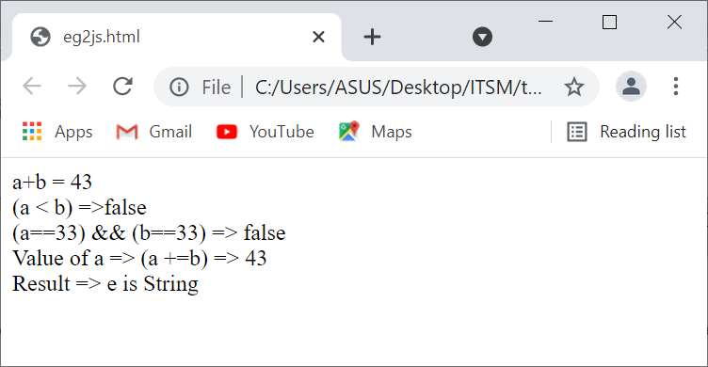
Example-2 Output:
Information Technology Supporting and Maintenance

Slide 17
Conditional Code
We have been using statements to execute our JavaScript code
Statements often have expressions
Expressions produce values
Decision points aren’t always simple
  What if you need to check for two conditions?
  What if one condition depends upon the value of another?
have two statement
  If-Else statement
  Switch statement
Information Technology Supporting and Maintenance

Slide 18
If-Else statement
Syntax
if(expression){
Statements to be executed if expression is true
}else{
Statements to be executed if expression is false
}
Information Technology Supporting and Maintenance

Slide 19
Example of If-Else Statement:
<html>
<head><title>Example of If-Else Statement</title></head>
<body>
<script type=“text/javascript”>
var age = 15;
if(age > 18){
document.write(“<b>Qualifies for driving</b>”);
}else{
document.write(“<b>Does not qualify for driving</b>”);
}
</script>
<p>Your result </p>
</body>
</html>
Information Technology Supporting and Maintenance

Slide 20
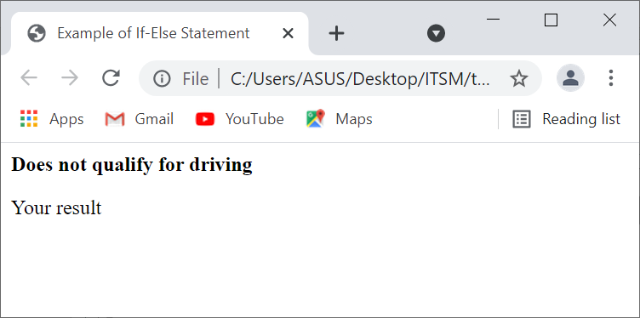
Example of If-Else Statement Output:
Information Technology Supporting and Maintenance

Slide 21
Switch statement
Syntax
switch(expression)
{
case condition1: statements
break;
case condition2: statements
break;
default : statements
}
Information Technology Supporting and Maintenance

Slide 22
Example of Switch Statement:
<html>
<head><title>Example of Switch Statement</title></head>
<body>
<script type=“text/javascript”>
var grade = ‘A’;
document.write(“Entering switch block<br>”);
switch(grade){
case ‘A’: document.write(“Good job<br>”);
break;
case ‘B’: document.write(“Normal <br>”);
break;
case ‘C’: document.write(“Not Good <br>”);
break;
default: document.write(“Unknown grade”);
}
</script>
<p>Your result </p>
</body>
</html>
Information Technology Supporting and Maintenance

Slide 23
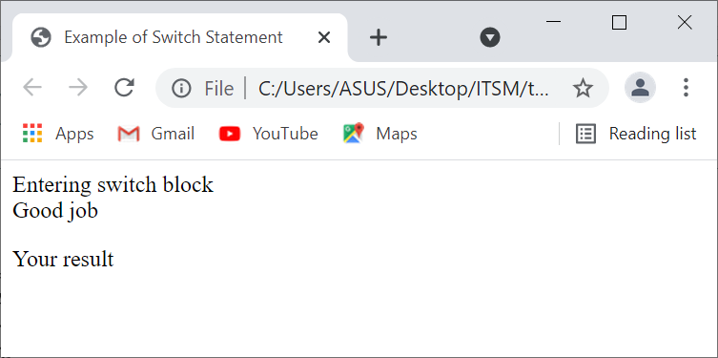
Example of Switch Statement Output:
Information Technology Supporting and Maintenance

Slide 24
Looping
Avoid writing the same (or similar) code over and over again.
Determine at runtime how many times you want to run some code.
  while loop
  do/while loop
  for loop
  for-In loop
Information Technology Supporting and Maintenance

Slide 25
while loop
Syntax
while(expression){
statement(s) to be executed if expression is true
}
Information Technology Supporting and Maintenance

Slide 26
Example of while Loop:
<html>
<head><title>Example of while Loop</title></head>
<body>
<script type=“text/javascript”>
var count = 0;
document.write(“Starting Loop”);
while(count < 10 ){
document.write(“Current Count:” + count + “<br>”);
count+=1;
}
document.write(“Loop stopped”);
</script>
</body>
</html>
Information Technology Supporting and Maintenance

Slide 27
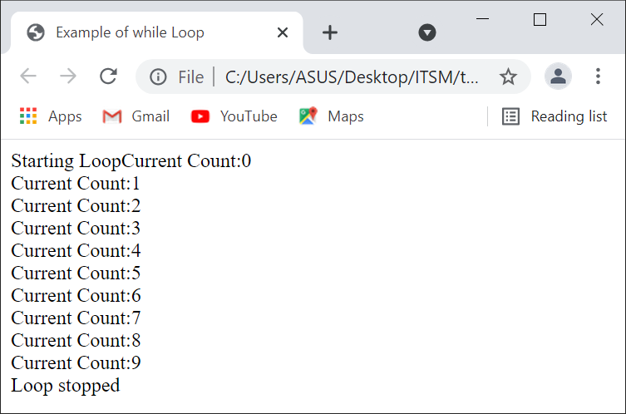
Example of while Loop Output:
Information Technology Supporting and Maintenance

Slide 28
do/while loop
Syntax
do{
Statements to be executed;
}while(expression);
Information Technology Supporting and Maintenance

Slide 29
Example of do/while Loop:
<html>
<head><title>Example of do/while Loop</title></head>
<body>
<script type=“text/javascript”>
var count = 0;
document.write(“Starting Loop”);
do{
document.write(“Current Count:” + count + “<br>”);
count++;
}while(count < 5);
document.write(“Loop stopped”);
</script>
</body>
</html>
Information Technology Supporting and Maintenance

Slide 30
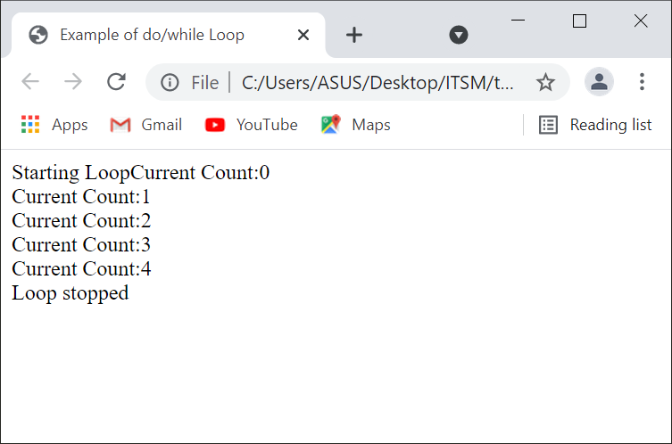
Example of do/while Loop Output:
Information Technology Supporting and Maintenance

Slide 31
for loop
Syntax
  for( initialization; test condition; iteration statement){
  Statements to be executed if test condition is true
  }
Information Technology Supporting and Maintenance

Slide 32
Example of for Loop:
<html>
<head><title>Example of for Loop</title></head>
<body>
<script type=“text/javascript”>
document.write(“Starting Loop”);
for(var count=0; count < 10; count++){
document.write(“Current Count:” + count + “<br>”);
}
document.write(“Loop stopped”);
</script>
</body>
</html>
Information Technology Supporting and Maintenance

Slide 33
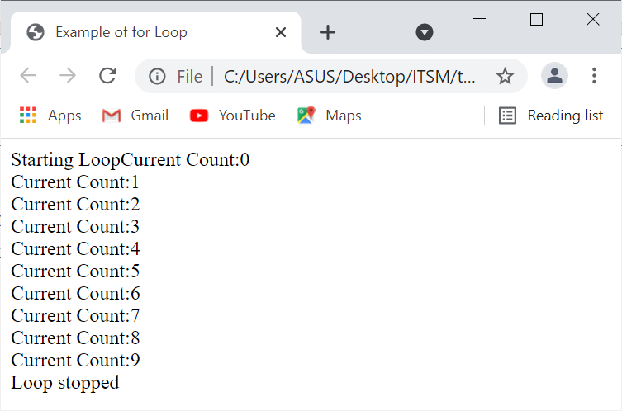
Example of for Loop Output:
Information Technology Supporting and Maintenance

Slide 34
for-In loop
Syntax
  for(variable_name in object){
  Statements or block to execute
  }
Information Technology Supporting and Maintenance

Slide 35
Example of for-in Loop:
<!DOCTYPE html>
<html lang=“en”>
<head><title>Example for...in loop</title>
<meta charset=“utf-8”>
</head>
<body>
<script type="text/javascript">
var string = 'code';
// using for...in loop
for (var i in string) {
document.write(string[i]+"<br>");
}
</script>
</body>
</html>
Information Technology Supporting and Maintenance

Slide 36
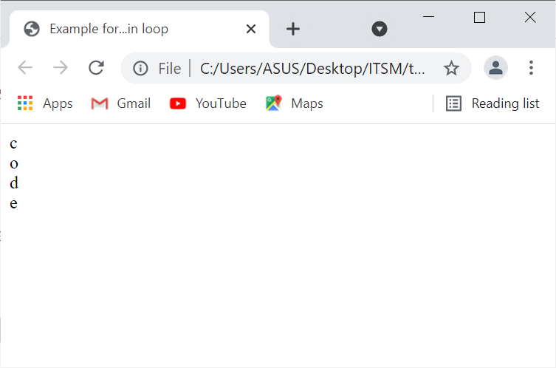
Example of for-in Loop Output:
Information Technology Supporting and Maintenance

Slide 37
Function
Reuse code multiple times, but only write it once
Use code from others
Syntax
  <script type=“text/javascript”>
  function functionName(argument[0],argument[1],…,argument[n])
  {
  statements
  // return value
  }
  functionName(parameter[0],parameter[1],…parameter[n]);
  </script>
Parameter
Argument
Information Technology Supporting and Maintenance

Slide 38
Function Parameters and Declaration
Sometimes functions need some information in order to perform its “function”
The names of the parameters are not important, as long as you are consistent
syntax:
function welcomeMsg()
{
alert(“Welcome to JavaScript”);
}
function welcomeMsg(msg)
{
alert(msg);
}
Information Technology Supporting and Maintenance

Slide 39
Function call and Return values
Declaring a function doesn’t actual do anything
You need to call the function
Calling a function changes the program flow
Some function return values
These values can be used in assignment statements or conditional expressions
eg: function welcomeMsg(msg){
alert(msg);
}
var x=“Hello”;
welcomeMsg(x);
x=“Goodbye”;
welcomeMsg(x);
Information Technology Supporting and Maintenance

Slide 40
Example of function:
<html>
<head>
<title>Example of function</title>
<script type=“text/javascript”>
function welcomeMsg(msg){
alert(msg);
var name=prompt(“What is your name?”);
return name;}
var firstName=welcomeMsg(“Hi”);
document.write(firstName+”<br>”);
</script>
</head>
<body>
Hi!
</body>
</html>
Information Technology Supporting and Maintenance

Slide 41
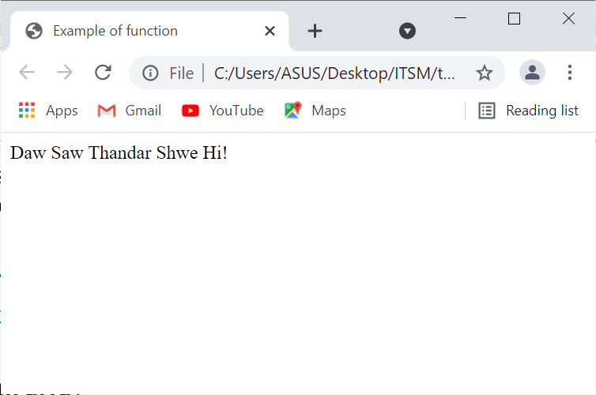
Example of function Output:
Information Technology Supporting and Maintenance

Slide 42
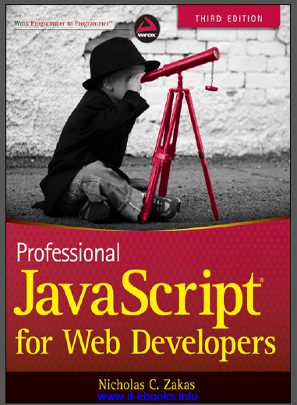
References
“PROFESSIONAL JavaScript for web Developers”
Third Edition
Zichalos C.Zakas
Nicholas, “Professional JavaScript for Web Development”
Colleen van Lent Ph.D, “INTERACTIVITY WITH JAVASCRIPT”
Information Technology Supporting and Maintenance

Slide 43
Thank You
1
Information Technology Supporting and Maintenance

